Slide 1
Verification of the Multiscale Model for CNT/Epoxy Nanocomposites
Elizabeth Quigley, Nithya Subramanian, Aditi Chattopadhyay
Arizona State University: School for Engineering of Matter, Transport, and Energy
Arizona Space Grant Statewide Symposium
April 16th, 2016 Tucson, Arizona

Slide 2
Outline
Motivation
Methodology
Results
  Void Characterization
  0.5 wt% CNT
  1 wt% CNT
Observations
Concluding Remarks

Slide 3
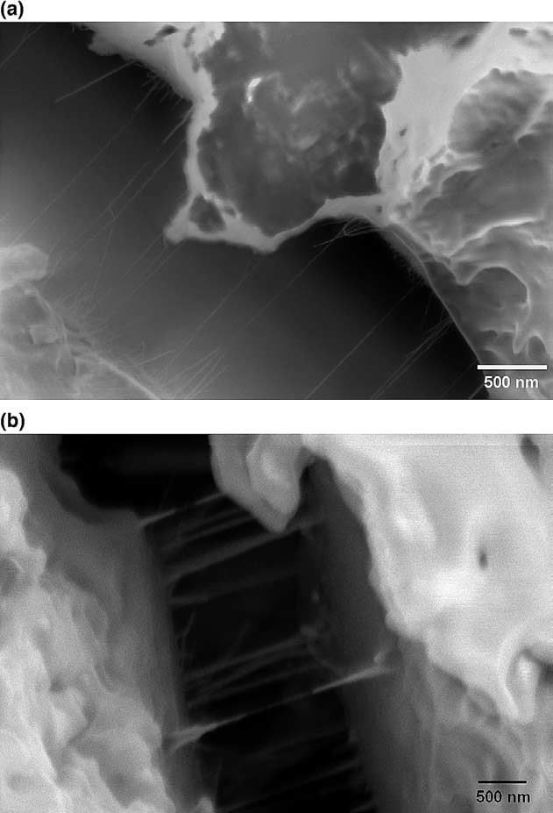
Motivation
CNTs enhance mechanical properties
  Strength
  Stiffness
  Fracture toughness
  Corrosion resistance
Lack of research into the effect of nanoparticles on bulk properties
Nanocomposites are studied more efficiently via modelling
  Weight fraction(wt%) of CNTs
  Degree of cross-linking
  Void size/density
Goal: verify accuracy of the multiscale model
Functionalized CNTs
Non-functionalized CNTs
Gojny et al., Compos. Sci. Technol. (2005)
Notes:
increase strength, stiffness, fracture toughness, and corrosion resistance.

Slide 4
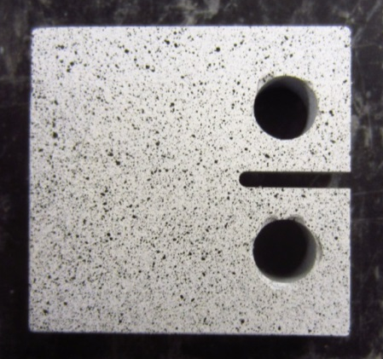
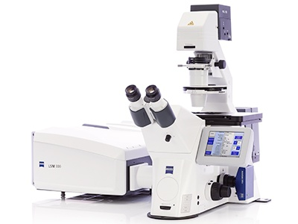
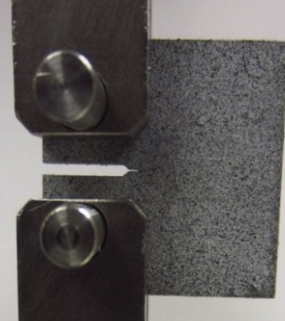

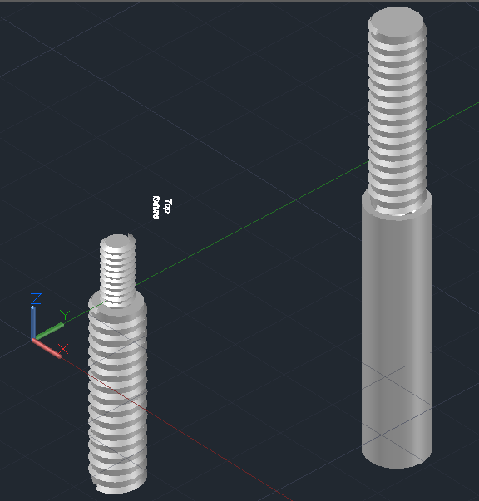
Methodology
Void Characterization:
  Polished epoxy pucks
  Optical microscopy with fluorescent filter (320-650 nm)
Specimen Fabrication
  Varying weight fractions of CNTs in epoxy
  Machined to specified shape
Mechanical Testing
  Mode 1 fracture testing
Completed fixture
Mode 1 fracture specimen
Zeiss optical microscope
No notch vs notch (pre-crack)
AutoCAD fixture design
Notes:
Values about voids were taken from literature; therefore, model may be inaccurate if epoxy used does not match literature values. Due to lack of time, only 0.5 wt% and 1 wt% results are shown today

Slide 5
Void Size/Distribution
Volume fraction of voids (density) was between 11-33%.
Distribution of void sizes. Most are between
30 – 60 um in area.
Values consistent with literature*
Volume fraction of voids (density) was between 11-33%.
Distribution of void sizes. Most are between
30 – 60 um in area.
*Huang, Y., & Kinloch, A. J., J. Mater. Sci. Lett .(1992)

Slide 6
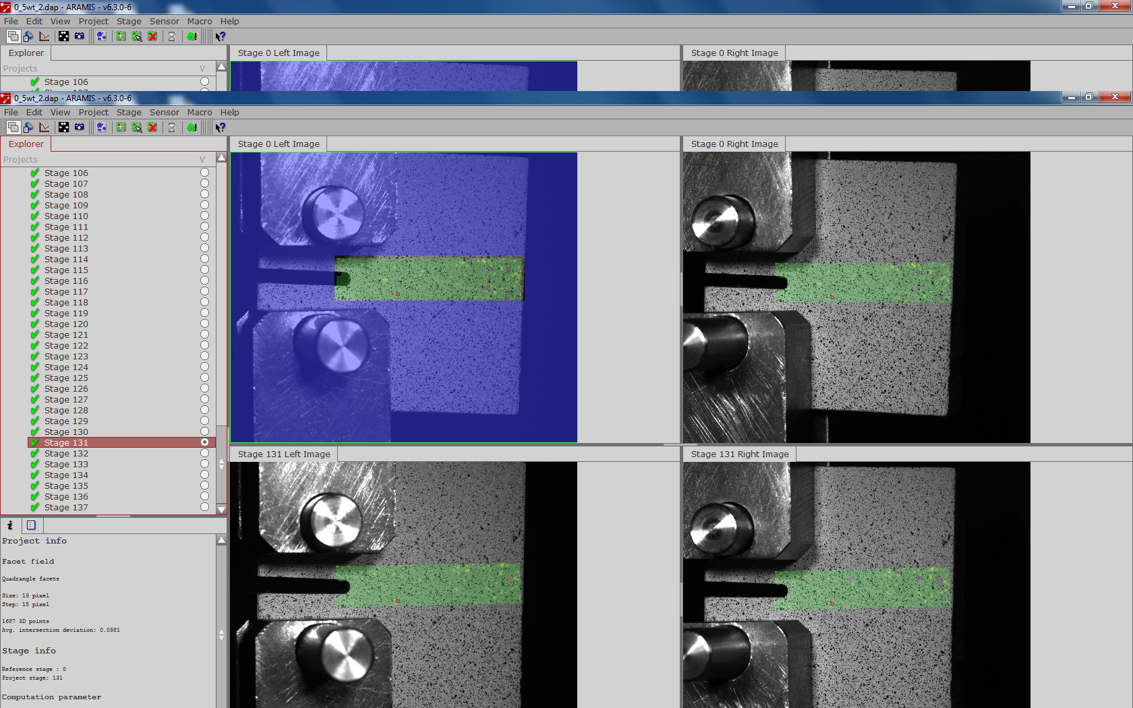
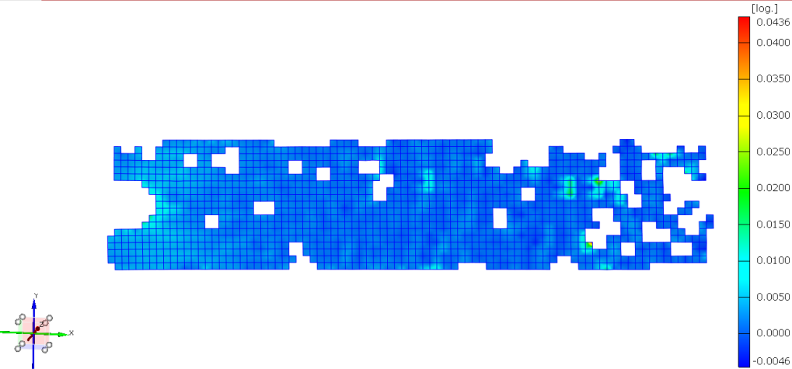
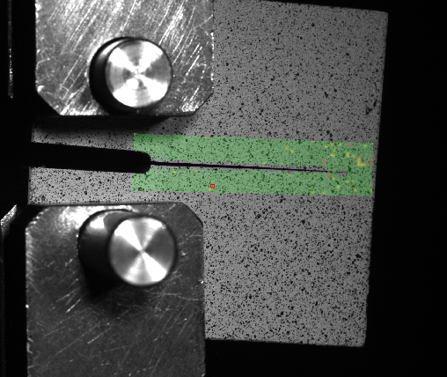
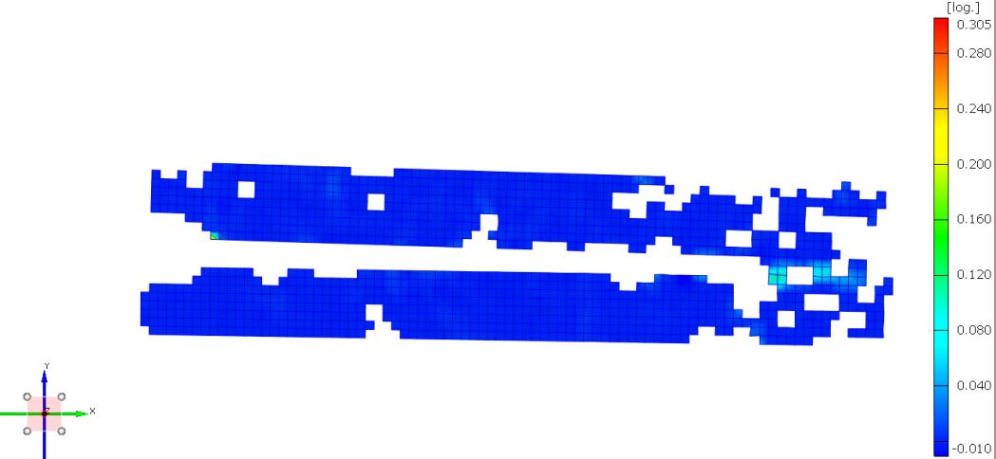
0.5 wt% CNT Specimen
Brittle fracture evident
Capturing crack propagation unsuccessful
Stage 102: Before fracture
Stage 103: After fracture

Slide 7
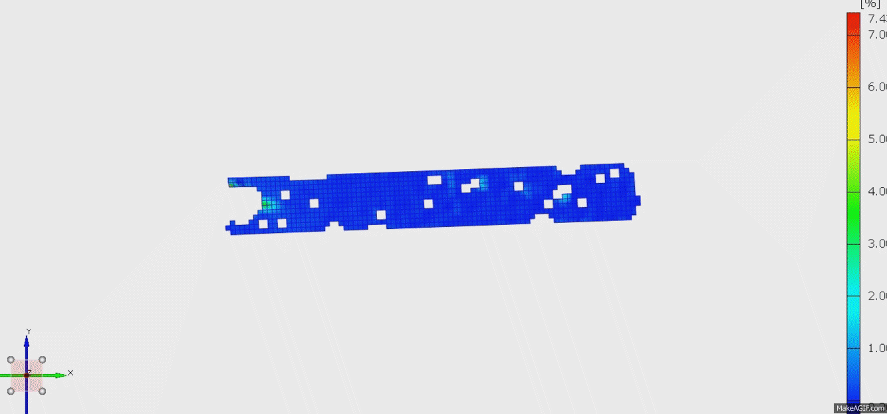
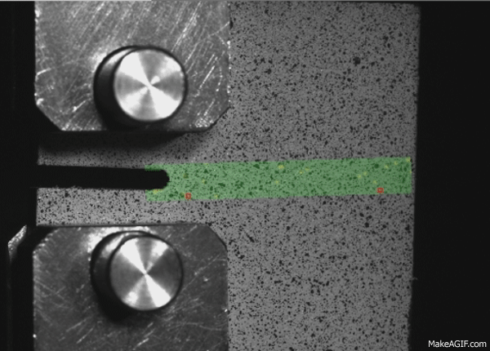
Crack Propagation
1 wt% CNT Sample
Successful progression from no crack to failure

Slide 8
Observations
Void characterization of epoxy was consistent with literature values
Addition of a notch (pre-crack) allowed for slower crack propagation
0.5 wt% was more brittle than expected -> wt% of CNTs not high enough to bridge fracture plane
1 wt% CNT had slower crack propagation
Strain measurements not fully captured -> requires finer speckled pattern
Preliminary results indicate that experimental results correlate with multiscale model results

Slide 9
Concluding Remarks
CNT/ epoxy nanocomposites were fabricated with varying weight fractions of CNTs
Voids in epoxy were characterized to determine if they matched with literature values used for the model.
Multiscale model initially verified but more samples need to be tested with greater accuracy
Successful verification of the model will expedite implementation of nanocomposites for space/ other applications

Slide 10
Acknowledgements
I would like to thank Nithya Subramanian and Dr. Aditi Chattopadhyay for their mentorship and support over the course of this project. I would also like to acknowledge the Office of Naval Research and the ASU/NASA Space Grant Program for funding this project.

Slide 11
References
[1] Zhang, Z., Gu, A., Liang, G., Ren, P., Xie, J., & Wang, X. (2007). Thermo-oxygen degradation mechanisms of POSS/epoxy nanocomposites. Polymer Degradation and Stability, 92(11), 1986-1993.
[2] Kinloch, A. J., Shaw, S. J., Tod, D. A., & Hunston, D. L. (1983). Deformation and fracture behaviour of a rubber-toughened epoxy: 1. Microstructure and fracture studies. Polymer, 24(10), 1341-1354.
[3] Gwynne, J. H., Oyen, M. L., & Cameron, R. E. (2010). Preparation of polymeric samples containing a graduated modulus region and development of nanoindentation linescan techniques. Polymer Testing, 29(4), 494-502.
[4] Oh, T. K., Hassan, M., Beatty, C., & El‐Shall, H. (2006). The effect of shear forces on the microstructure and mechanical properties of epoxy–clay nanocomposites. Journal of applied polymer science, 100(5), 3465-3473.
[5] Szymanski, C., Wu, C., Hooper, J., Salazar, M. A., Perdomo, A., Dukes, A., & McNeill, J. (2005). Single molecule nanoparticles of the conjugated polymer MEH-PPV, preparation and characterization by near-field scanning optical microscopy. The Journal of Physical Chemistry B, 109(18), 8543-8546.
[6] Liu, W., Hoa, S. V., & Pugh, M. (2004). Morphology and performance of epoxy nanocomposites modified with organoclay and rubber. Polymer Engineering & Science, 44(6), 1178-1186.
[7] Vanlandingham, M. R., Eduljee, R. F., & Gillespie Jr, J. W. (1999). Relationships between stoichiometry, microstructure, and properties for amine‐cured epoxies. Journal of Applied Polymer Science, 71(5), 699-712.
[8] Buchko, C. J., Chen, L. C., Shen, Y., & Martin, D. C. (1999). Processing and microstructural characterization of porous biocompatible protein polymer thin films. Polymer, 40(26), 7397-7407.
[9] Gojny, F. H., Wichmann, M. H., Fiedler, B., & Schulte, K. (2005). Influence of different carbon nanotubes on the mechanical properties of epoxy matrix composites–a comparative study. Composites Science and Technology,65(15), 2300-2313.
[10] Huang, Y., & Kinloch, A. J. (1992). The role of plastic void growth in the fracture of rubber-toughened epoxy polymers. Journal of materials science letters, 11(8), 484-487.

Slide 12
Questions?

